Slide 1
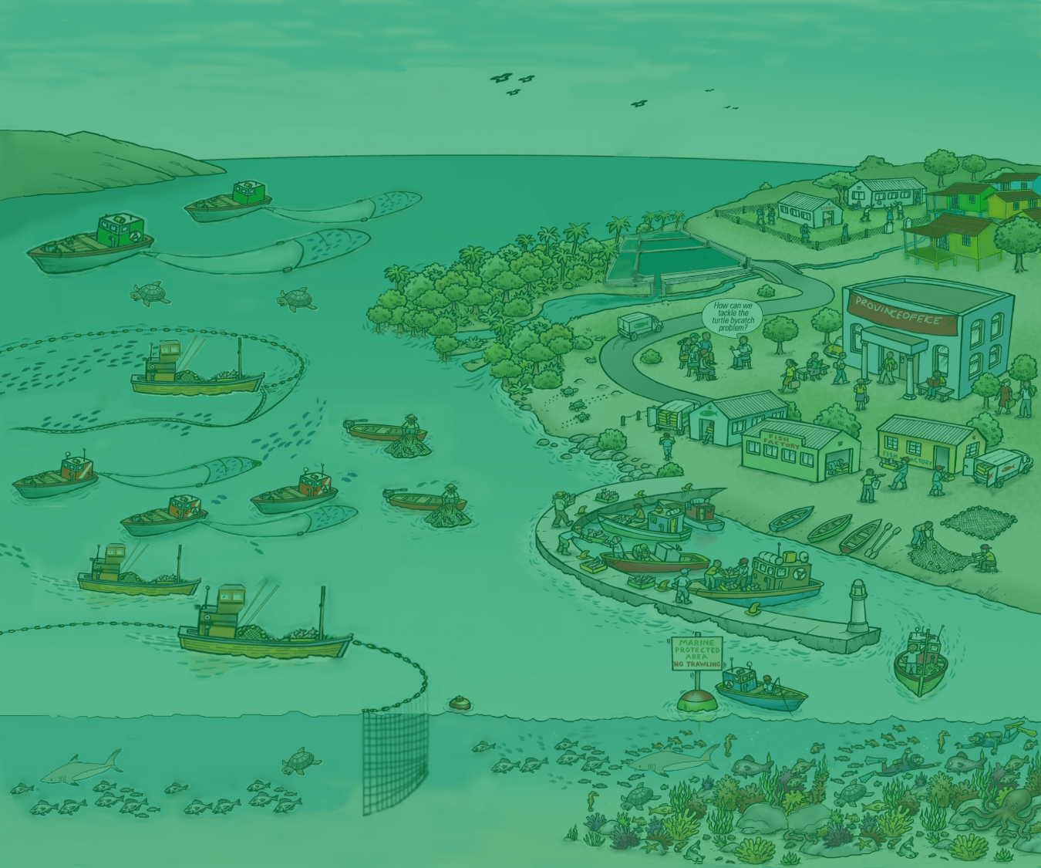

4. Principles of EAFM
Version 1

Slide 2








Key principles of EAFM
1. Good governance
2. Appropriate scale
3. Increased participation
4. Multiple objectives
5. Cooperation & coordination
6. Adaptive management
7. Precautionary approach
Notes:
Seven principles that distinguish EA from existing/conventional fisheries management;
Good governance: especially improving transparency and accountability;
Appropriate scale: takes account of scale and delivers at the appropriate scale for the issue: political, geographic, multi-sectoral;
Increased participation: Stakeholders need to work together in management planning and implementation (co-management);
Multiple objectives: Takes account of the different objectives of different stakeholders and considers trade-offs;
Cooperation and coordination: Needed horizontally across sectors and agencies and vertically across levels of government;
Adaptive management: Learn through controlled trial and error; and
Precautionary approach: Don’t delay action because of a lack of information and be risk averse when there is uncertainty

Slide 3
Principles are not new
The principles of EAFM are not new but were set out in the FAO Code of Conduct for Responsible Fisheries (CCRF)
The CCRF was developed by Food and Agriculture Organization of the United Nations (FAO)
All FAO Member countries agreed to CCRF in 1995
Indonesia is a Member of FAO
3
Notes:
Stress that the principles of EAFM are not new but grew out of the acceptance of the concept of sustainable development. For the sustainable development of fisheries, the FAO developed a Code of Responsible Fisheries, which was agreed to by all FAO member countries in 1995. All Asia-Pacific countries attending this course (with the exception of North Korea) are members of FAO.

Slide 4
P1
Good governance
Consensus
Accountable
GOOD GOVERNANCE
Participatory
Transparent
Follows the
rule of law
Responsive
Effective
and
efficient
Equitable and
inclusive
Source: http://www.unescap.org/pdd/prs/ProjectActivities/Ongoing/gg/governance.asp
4
Notes:
The First Principle of EAFM is Good governance. Good governance includes: effective institutions and arrangements for setting and implementing rules and regulations. This slide shows 8 characteristics of good governance. Discuss each of these; ensure participants agree with meaning. See Module 4, section 3.1 for details on each of these 8 characteristics.
(Accountability = both upwards and downwards)
Diagram from http://www.unescap.org/pdd/prs/ProjectActivities/Ongoing/gg/governance.asp

Slide 5
Appropriate scale
P2
Four dimensions:
Ecological scales
Socio-economic scales
Political/governance scales
Temporal scales
Note: These align with the three components of EAFM
5
Notes:
These align with the 3 components of EAFM (introduced in morning session 2). The 3 main scaling dimensions are (i) Ecological scaling – trying to align with ecosystem boundaries, (ii) Socio-economic scaling – trying to include the appropriate socio-economic issues and (iii) political/governance scaling – who has the mandate to manage. Also scaling needs to consider changes over time i.e. temporal.
See Module 4 section 3.2 for details.

Slide 6
Scales – extremes
Ecological
Single species ➔ Large Marine Ecosystem
Socio-economic
Village ➔ Coastline (rural & urban)
Governance
Single jurisdiction ➔ Multiple jurisdictions
Temporal
Short-term ➔ Long-term
6
Notes:
To try and clarify what we mean by scaling, we can consider two extremes along each of the 4 dimensions i.e. (i) from single species to large marine ecosystems, (ii) from a village up to a whole coastline, (iii) from a single jurisdiction to multiple jurisdictions and (iv) from short-term to long-term considerations.

Slide 7
Realities of scale
Probably no such thing as a correct scale
Take a practical approach – begin working with what exists e.g. jurisdictional boundaries
Challenge:
Getting the scale correct for the four dimensions.
This often requires increased cooperation and coordination across jurisdictions, agencies and stakeholders.
7
Notes:
The ideal scale is based on an ecosystem scale.
However, in reality the scale at which fishery management occurs will be primarily determined by existing jurisdictional and political boundaries, but there are some general socio-economic and ecological issues, which, if considered would help broaden the mandate of fisheries management.
It is best to work with practical scales and boundaries- this means that the stock or fishery under consideration should also be framed within meaningful jurisdictional boundaries. (e.g. state or province level).

Slide 8
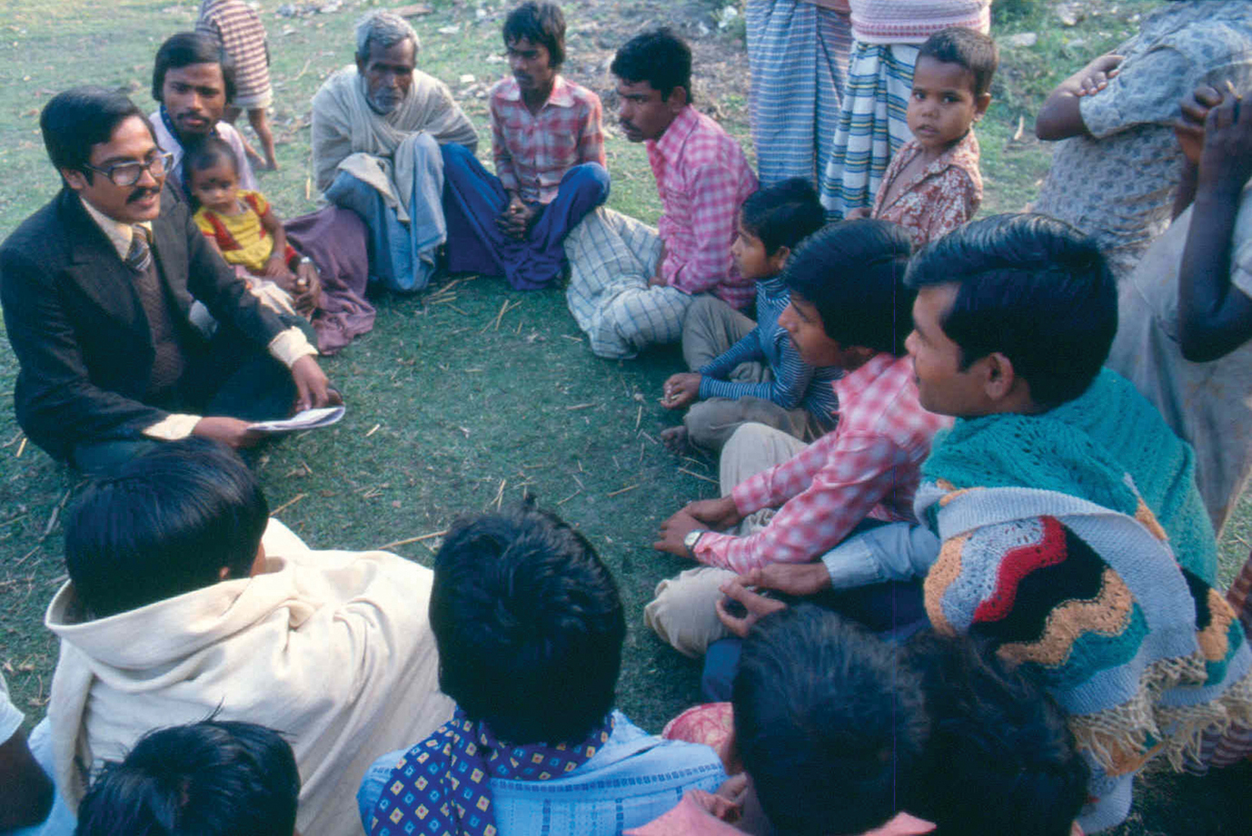
Increased participation
P3
Participation is central to the process
8
Notes:
Much more on the importance of participation later in the course. See module 4 Principles, section 3.3 for more details.
Get participants to say why this is actually NOT ideal photo of participation (no women stakeholders; clothing of speaker (suit and tie) suggests hierarchy….
To foster participation facilitator needs to try to ‘blend’ in more; also paper notes (power) are not shared (they are held by the speaker).
Photo source: FAO.

Slide 9
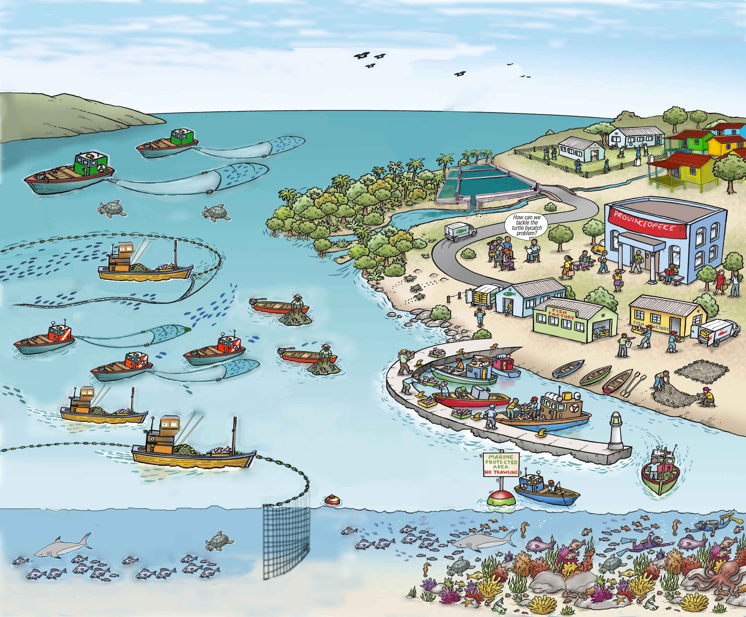
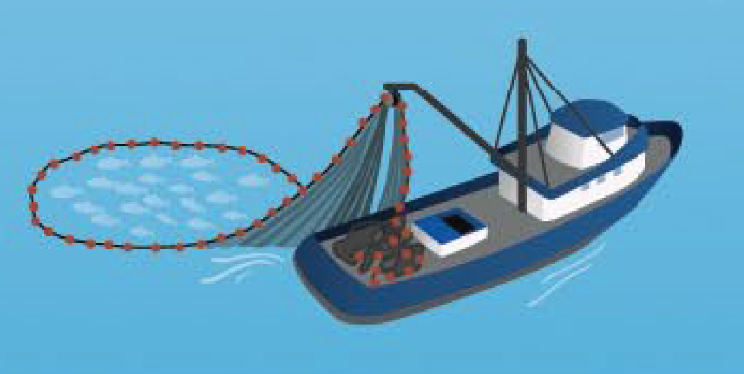
P4
Multiple objectives
EAFM deals with interactions within the fishery sector and with other users
Each sector and user group
probably have their own objectives
Need to balance these objectives
Requires stakeholder engagement and negotiation
9
Notes:
Because EAFM is finding the balance between ecological well-being and human well-being, there will be many objectives coming from the different stakeholders (jargon for this is societal objectives). In many cases, these objectives will conflict and, as an important principle of EAFM we need to address these multiple objectives and find TRADE OFFS (as we started discussing when watching Nemo video clip in session before lunch).

Slide 10
P5
Cooperation and coordination
EAFM involves cooperation and coordination among many stakeholders e.g.
Fishers
Fisher associations
External agents
NGOs, academics,
researchers
Government
National/regional/
provincial/state/
municipal/
village
within agency/institutions
across institutions, both government and stakeholder and with non-fishery sectors
from global to national to district levels
10
Notes:
For EAFM it is necessary to coordinate and cooperate (i) horizontally: within and across institutions/agencies, both government and stakeholder, and also with non-fishery sectors, and (ii) vertically from national to district levels.

Slide 11
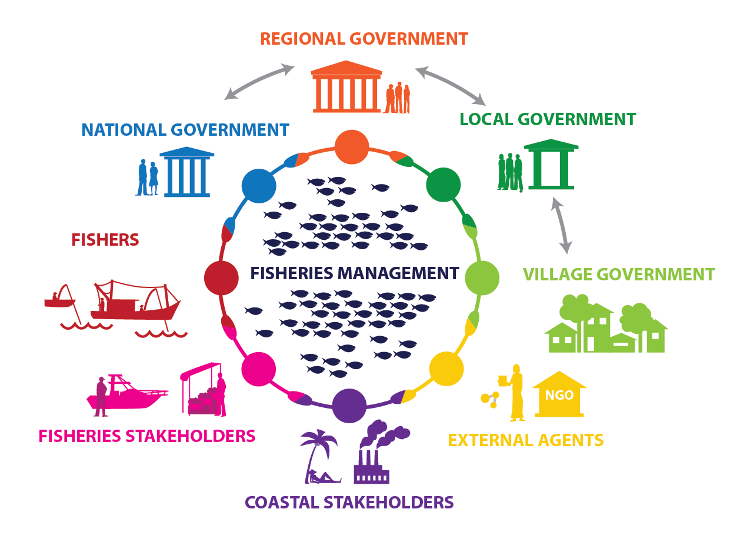
The institutions
11
Notes:
This is a visual of the main actors and required linkages. Going clockwise from the bottom, point out stakeholders that affect or are affected by the fishery. These are (i) coastal communities, (ii) fishers, (iii) governments at various levels and lastly (iv), what is called here “external agents”. Other agencies could include Research Institutes, Enforcement Officers (e.g. navy and coast guard), etc.

Slide 12


P7
Adaptive management
Learning while doing
P6
Evaluate
Improve
Discard
Work
Evaluate
Improve
Discard
Work
Evaluate
Improve
Discard
P6
More uncertainty
Less uncertainty
TIME
12
Notes:
In adaptive management you start management actions as soon as practical and despite uncertainty and learn from what you have done by evaluating the outcome. Over time, the lessons learnt will reduce the uncertainty.
Adaptive management provides a framework for managing for change over time by learning from doing.
One big advantage of adaptive management is that it can be used in data-poor situations.
One example is reducing fishing effort. All the existing evidence highlights the need for a reduction of fishing effort. However, we do not know what the optimum fishing effort level really is. In this case, you start reducing and monitor the result until, several years later the optimal effort is more obvious.
This links closely to the precautionary principle (next slide). In the example, you do not have to know what the optimum level is to start managing.

Slide 13
P7
The precautionary approach
“… where there are threats of serious or irreversible damage, lack of full scientific certainty shall not be used as a reason for postponing cost-effective measures to prevent environmental degradation” (UNCED, 1992)
Lack of information should not be used as reason for lack of action
Where there is uncertainty, management actions should be less risky
13
Notes:
From UNCED 1992. Links closely with the principle of adaptive management. Simply put (i) you do not wait until you have all your scientific data before you make decisions/ act/ manage, and (ii) it also means that where there is uncertainty, any actions need to be less risky.
An example: Country xxx knows that there are untapped fishery resources in offshore waters. However, the extent of the resource is not known. Rather than doing more research cruises, the fishery is opened to only a limited number of boats (2-3) which, in exchange for the right to fish, must provide data on catch, effort and costs. From this data, the extent of the resource will become more certain and the number of boats can be adjusted accordingly.
See next slide for another example.

Slide 14
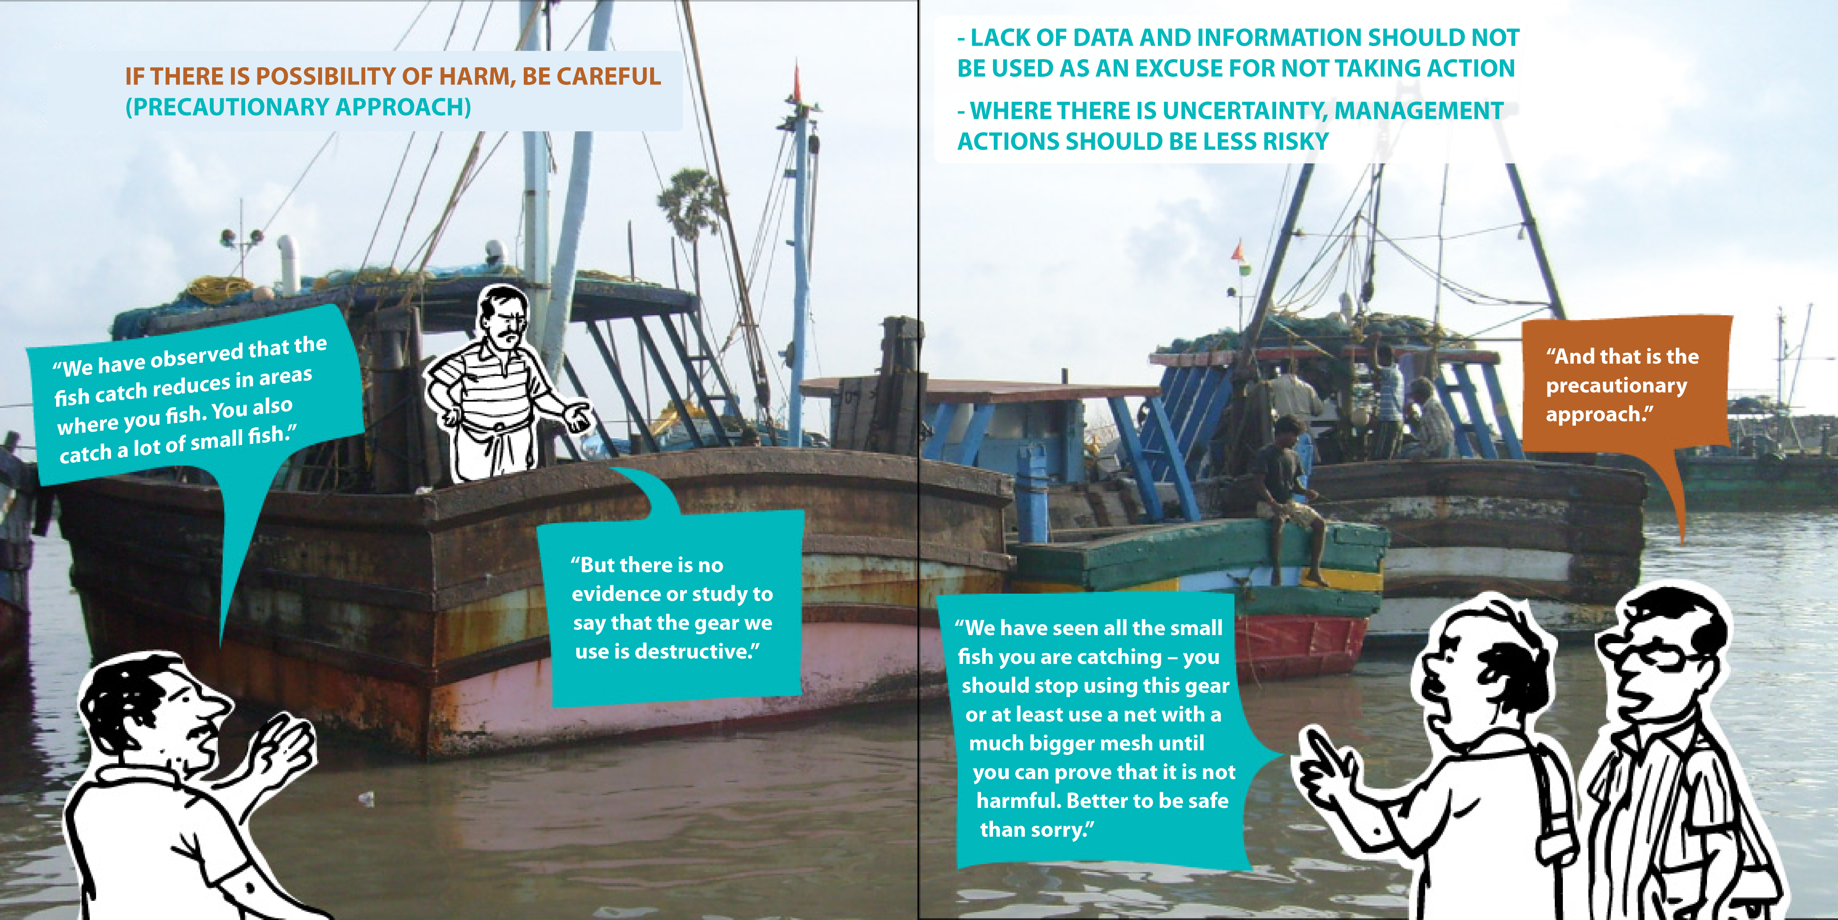
THE PRECAUTIONARY APPROACH
Source: Adapted from ICSF (2013)
14
Notes:
Here is another example. In this example it is known that when fishers fish in an area with certain gear (e.g. small mesh trawls), they catch small fish and also the catch of fish for other gears is less. However, there is no evidence of this. Faced with this uncertainty, it was decided to introduce bigger mesh sizes until the fishers could prove that their small-meshed nets were not causing any harm.

Slide 15
Key messages
EAFM principles are not new – based on the FAO Code of Conduct for Fisheries (to which your country is a member)
EAFM has seven principles
  These can be used to track EAFM implementation
15
Notes:
Self explanatory

